Slide 1
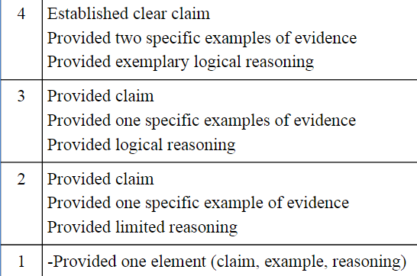
Claim
Evidence
Reasoning

