Slide 1
Economy Basics
Natural Resources
Supply and Demand

Slide 2
Natural Resources
materials or substances such as minerals, forests, water, and fertile land that occur in nature and can be used for economic gain.

Slide 3
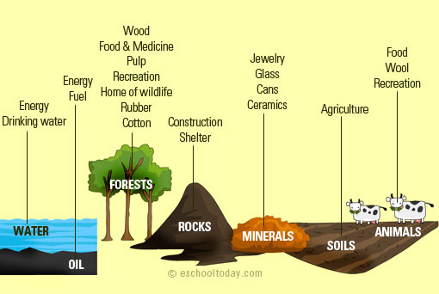

Slide 4
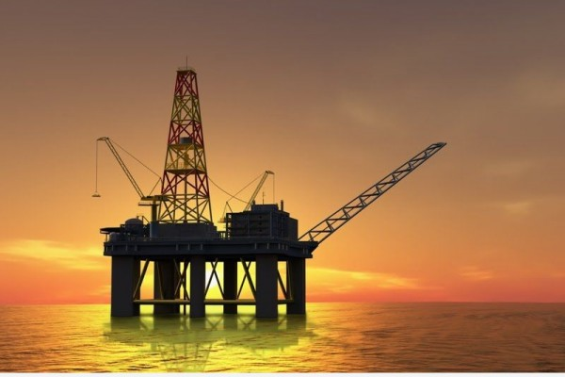
Oil Oil Rig in Somalian water (NE Africa)

Slide 5
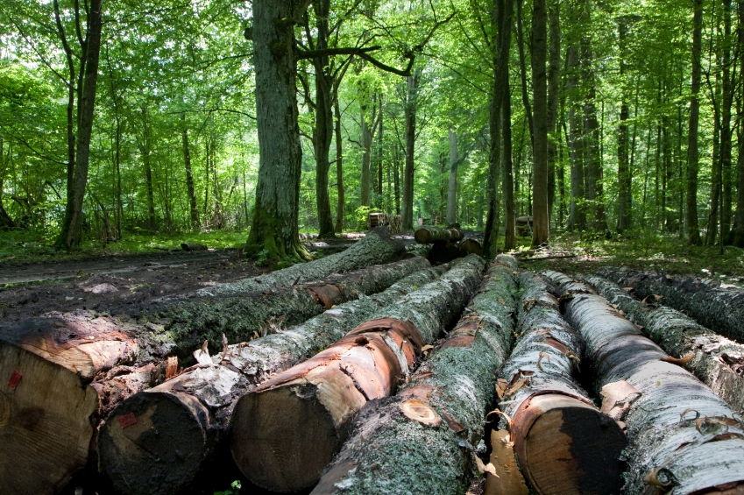
Forests Logging in California, USA

Slide 6
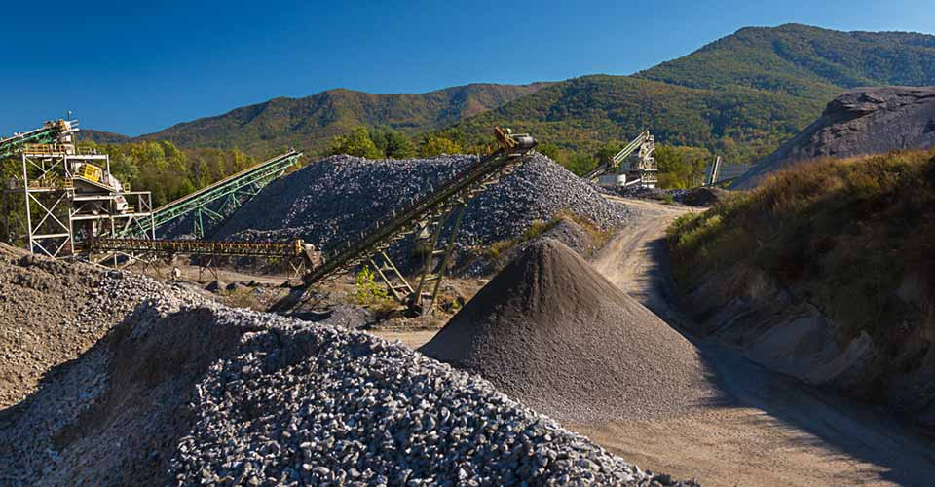
Rocks Rock Quarry in Black Mountain, NC

Slide 7
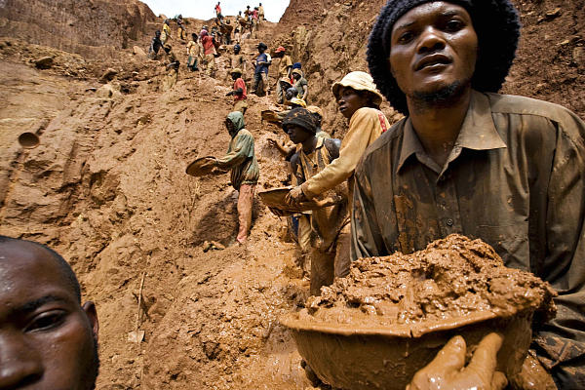
Minerals mining Tungsten in the Congo (Central Africa)

Slide 8
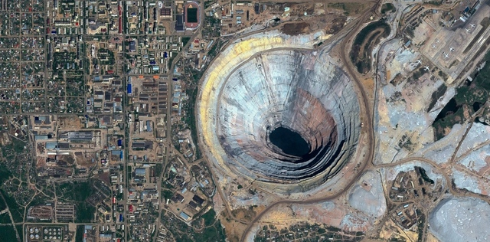
Minerals Diamond Mine in
Siberia, Russia

Slide 9
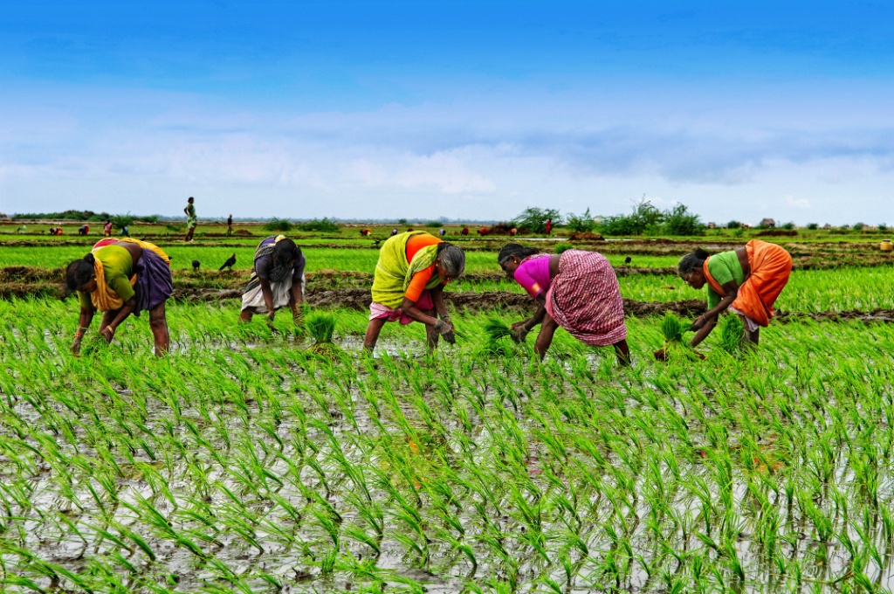
Agriculture rice Field in Nepal (NE of India)

Slide 10
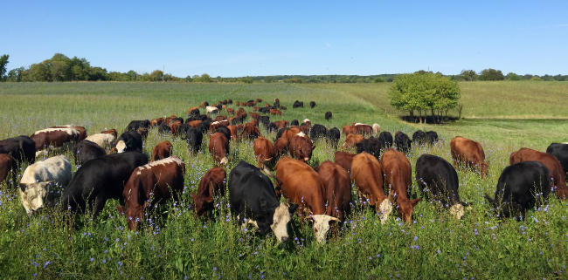
Animals Cattle in MinneSota

Slide 11
Supply and Demand
the amount of a good or service available and the desire of buyers for it, affect its price.

Slide 12
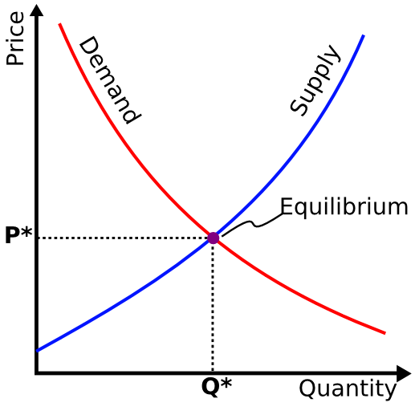

Slide 14
