Slide 1
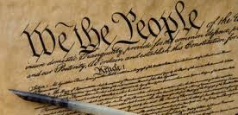
Primary Source
an artifact, document, or other source of information that was created at the time it describes; an original source of information about the topic

Slide 2
Secondary Source
a source about an event, period, or issue in history that was produced after that event (i.e textbook)

Slide 3
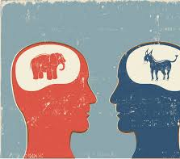
Bias
prejudice in favor of or against one thing, person, or group; a person's point-of-view

Slide 4
Economics
the study of making, buying, selling and trading of wealth/money/resources.

Slide 5
Government
the governing body of a nation or state; makes laws and rules in order to protect its citizens

Slide 6
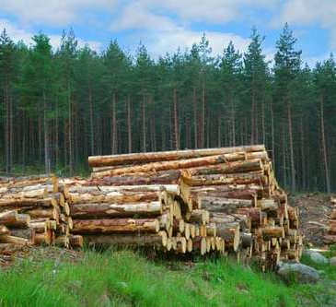
Natural Resources
Materials such as minerals, forests, water, and fertile land that occur in nature and can be used for economic gain

Slide 7
Physical Features
Geographic features you can see (rivers, lakes, mountains, desert, etc)

Slide 8
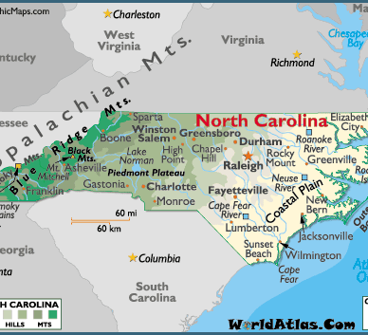
Relative Location
a place based on a larger geographic view or location near landmarks (city and state)

Slide 9
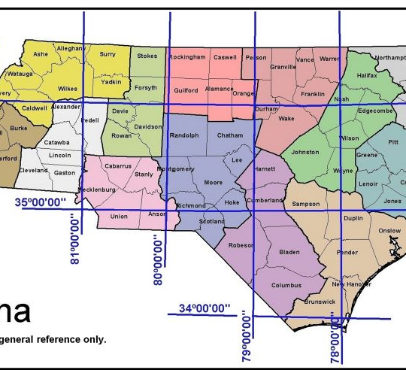
Absolute Location
a place on the Earth's surface based on specific geographic coordinates (latitude and longitude)

Slide 10
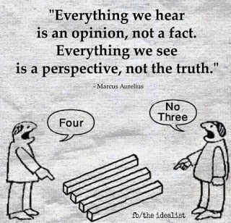
Perspective
Point of view

Slide 11
Validity
measures the truth and fairness of a given story or article

Slide 12
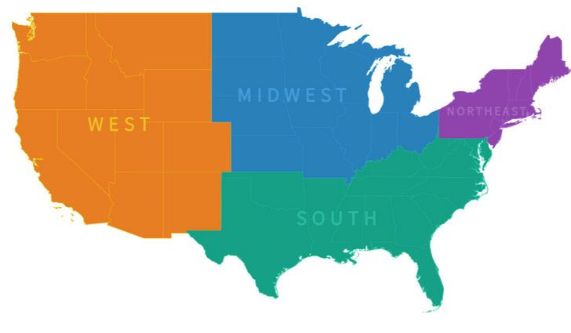
Region
area on Earth defined by cultural or physical identity

Slide 13
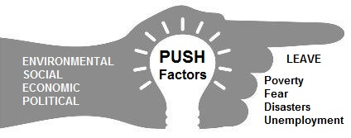
Push Factors
a factor that makes people leave

Slide 14
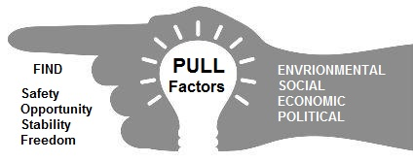
Pull Factors
A factor that draws or attracts people to move to another location

Slide 15
Fake News
content, articles, videos that present made up or false information

Slide 16
Culture
Beliefs, customs, and traditions of a specific group of people (ex. religion, language, food, fashion...)

