Slide 1
Korean War Analysis

Slide 2
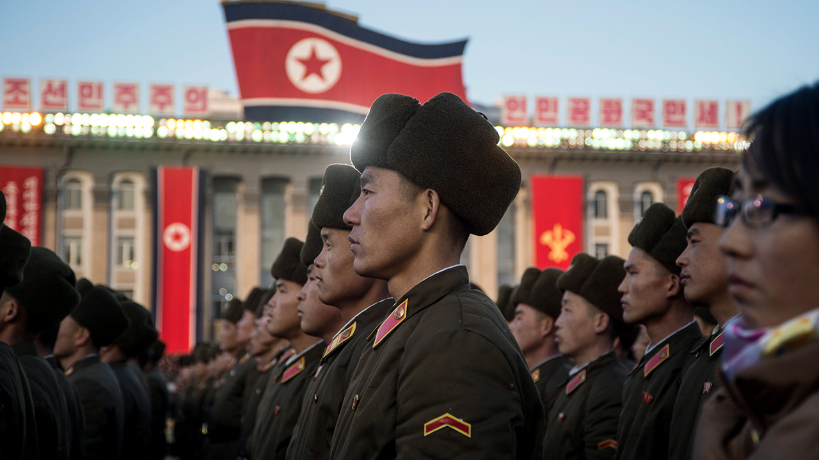
North Korea

Slide 3
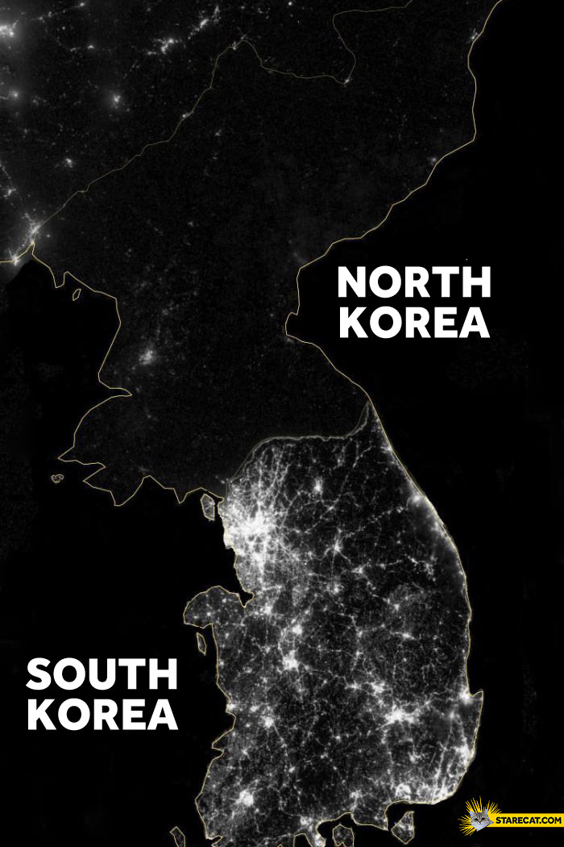
North Korea South Korea
Communist Democracy
Dictatorship Capitalism

Slide 7
Korean War Textbook Bias Analysis
1. According to each textbook, how did the Korean War Start?
Textbook A:
Textbook B:
2. Which of these textbooks do you find more trustworthy? Why? (Use specific examples as evidence)
3. Which one do you believe is North Korea? Why?
4. Which one do you believe is South Korea? Why?

